Slide 1

Secure Online Voting
Debabrata Bhattacharya
Poulamee Thakur
Trisha Ghosh
Soumya Dutta

Slide 2
Contents
Introduction
Our System
Steps to be followed
Technology Leveraged
Target Audience
Screenshots

Slide 3

Introduction
Online voting or E-voting refers to voting using electronic means such as an android smartphone.
The project suggests the use of hashing. Authentication is made by comparing hashes using SHA-256.
This way the system is more secured.
Vote can be audited later by comparing hashes in a database.

Slide 4
Our System
Relevant agencies use the National Electoral Roll database to send all registered voters a letter with information about the voting process.
The user opens the app and scans 2 pieces of information from the letter:
1. Information that authenticates him and his vote
2. The code that indicates his vote
A ready-to-send email is generated with the two pieces of information.
The government can then audit the vote itself with the relevant information provided, ensuring a reliable and rigorous election.

Slide 5
Steps To Be Followed
1. User receives a letter with scan-able information.
2. User opens the app and scans his own information as well as the candidate he chooses to vote for.
3. An email in the Gmail App is automatically generated with encrypted data.
4. The user sends this email.
5. Email received is used to count votes for candidates.
6. The received email is verified and will count as a single vote.
7. The vote can be audited by verifying hashed user information.

Slide 6
Advantages
1. The system can be used anytime and from anywhere by the Voters.
2. No one can cast votes on behalf of others and multiple times.
3. Saves time and reduces human intervention.
4. The system is flexible and secured to be used.
5. Unique Identification of voter through user info hashes.

Slide 7
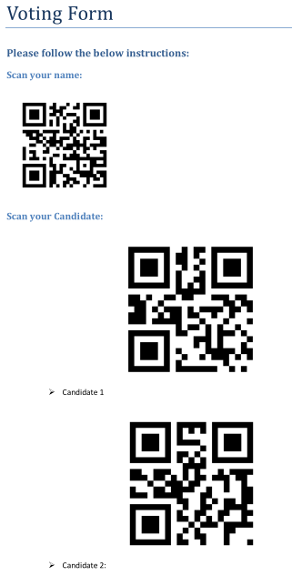

Screenshots
Voting Form
Splash Screen

Slide 8
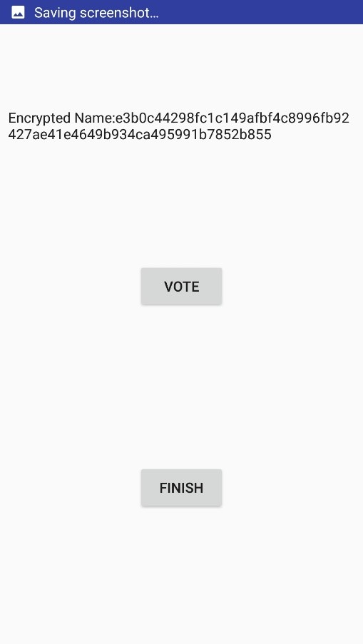
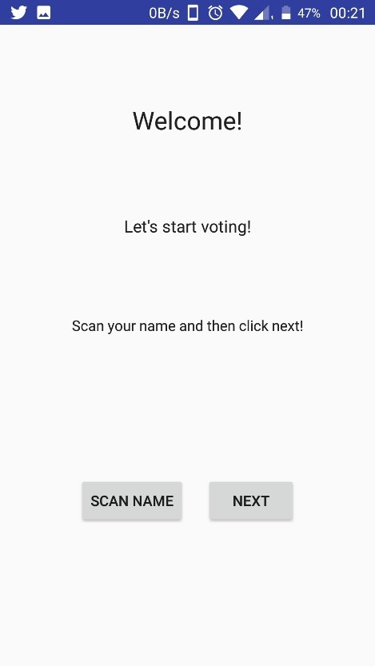
Screenshots
Welcome Screen
Voting Screen

Slide 9
Conclusion
By online voting system percentage of voting is increases and cost and time of voting process is decreases.
It is easy to use and it is less time consuming.
It is very easy to debug.

Slide 10
Thank You!!

